Slide 1
Semiconductor Growth: Bulk and Low dimensional system
PHY 312

Slide 2

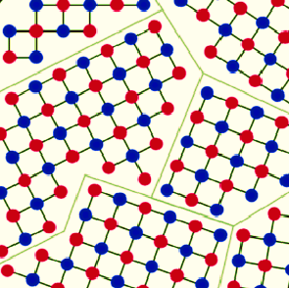
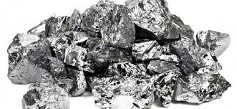
Semiconductor growth (Si)
1. Removal of ‘O’ at 1800 °C
SiO₂ + 2C → Si + 2CO
Metallic grade semiconductor
~2N pure, Impurity: ~10¹⁸ cm⁻³
2. Refinement using chemicals
Si + 3HCl → SiHCl₃ + H₂
Sands: silicon dioxide (SiO₂)
3. Heating (~ 1000 °C) under H₂
SiHCl₃ + H₂ → Si + 3HCl
This is still polycrystalline Si..
Electronic-Grade Semiconductor
>9 N pure, Impurity: ~10¹¹ cm⁻³

Slide 3
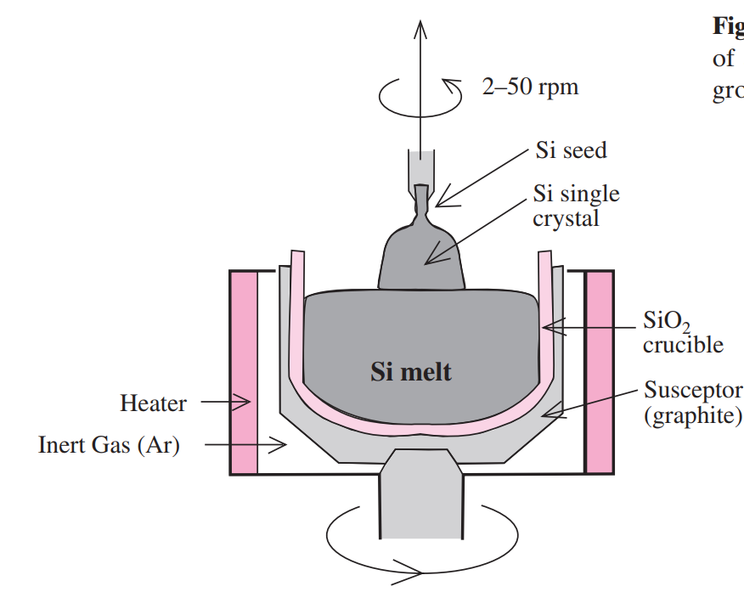
Czochralski Growth
Seed: A single crystal of silicon
Graphite/SiO₂ crucible at ~1450 °C
Seed is slowly pulled out
Both seed and crucible are rotated

Slide 4
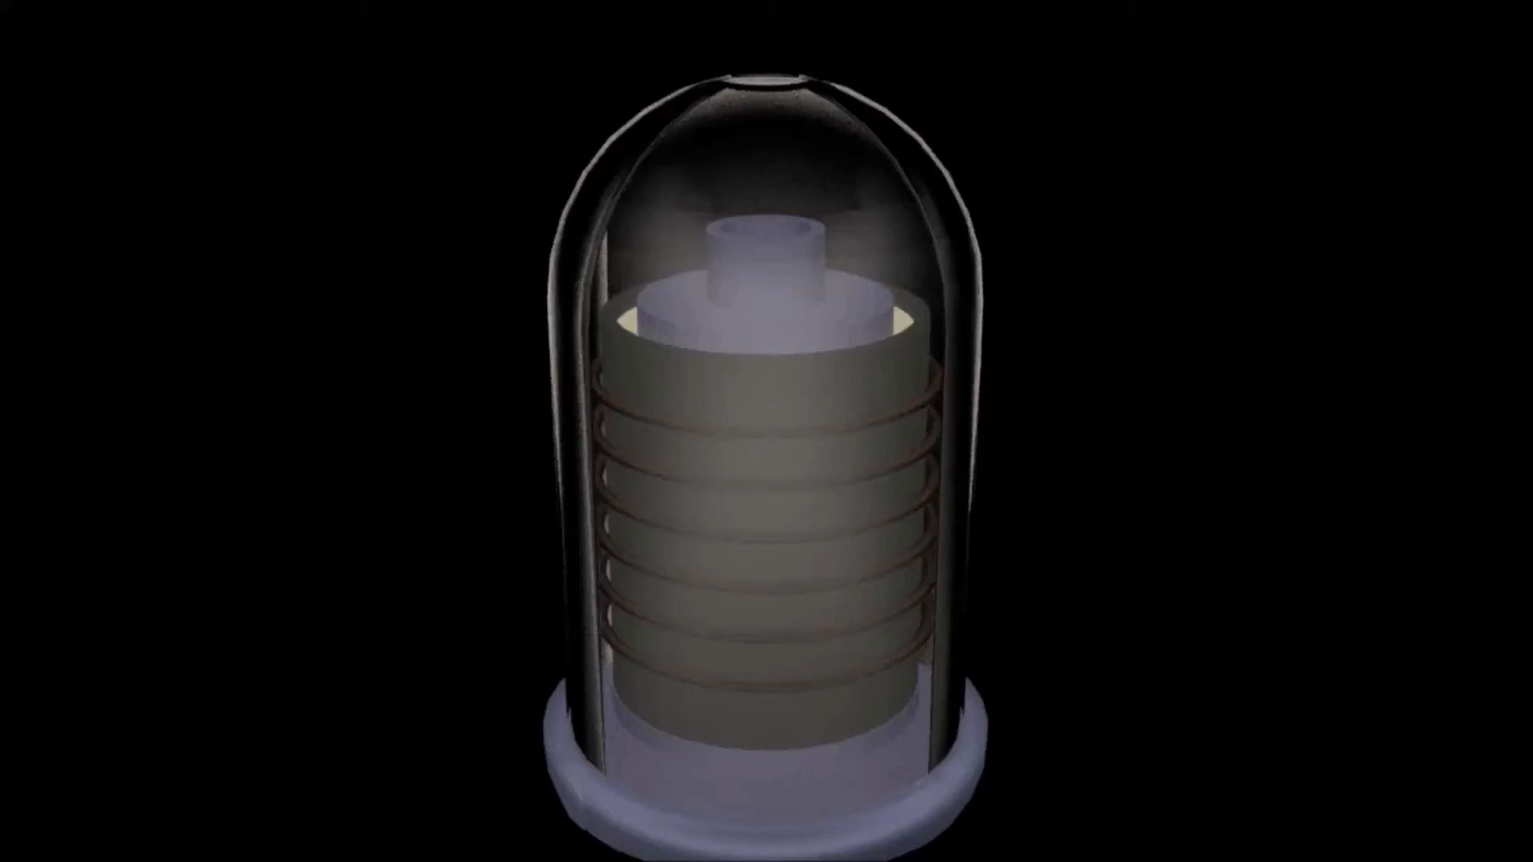
Czochralski Growth
Video: YouTube

Slide 5
Bridgman Growth
Seed: A single crystal of silicon
Graphite/SiO₂ crucible at ~1450 °C
The silicon is selectively melted to crystallize
Lowering
Temperature
Heating
Heater coil
Position
Melt
Solid
Cooling
Seed

Slide 6
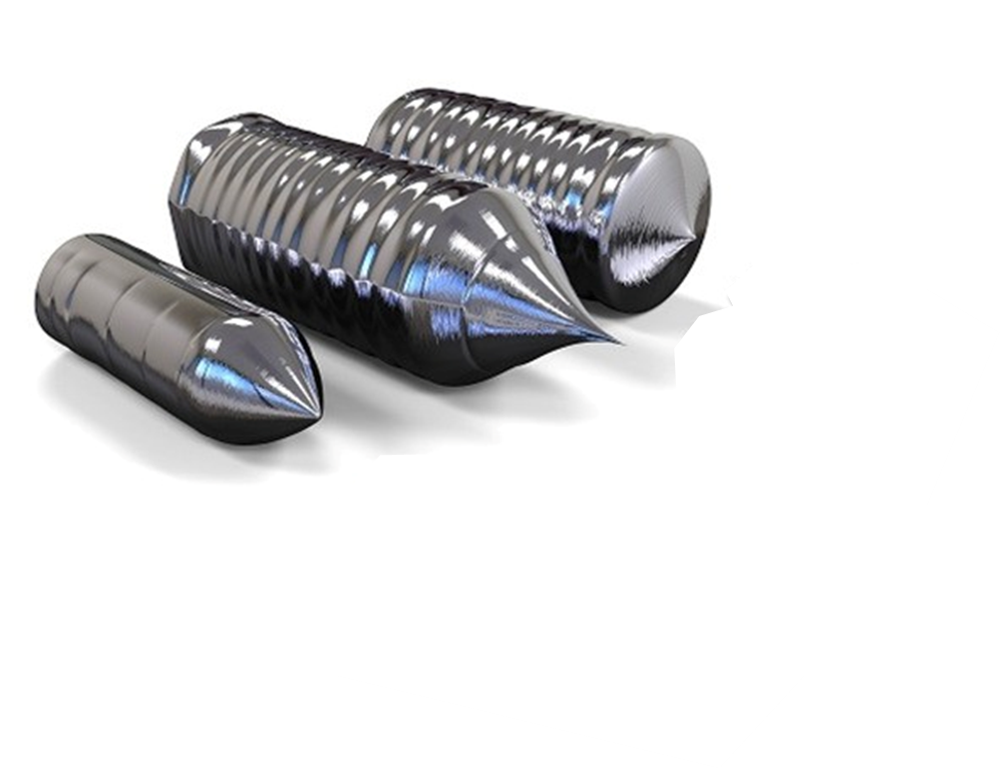
Silicon Ingot

Slide 7
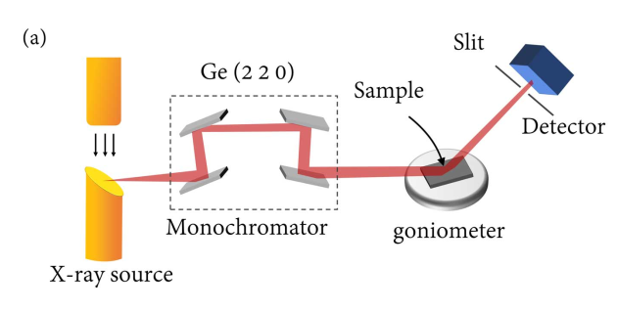
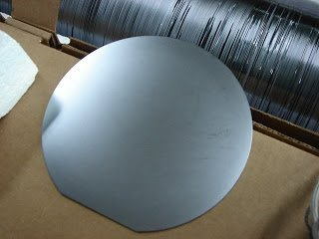
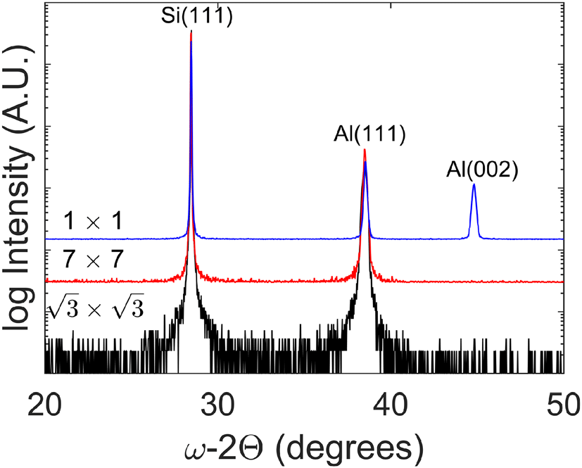
Identification of crystal planes
Notch Cut along {110}

Slide 8
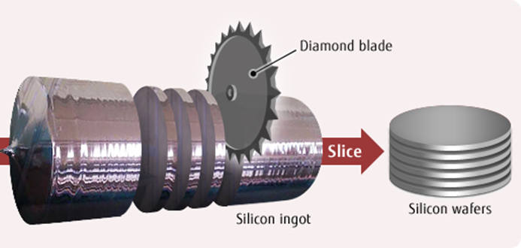
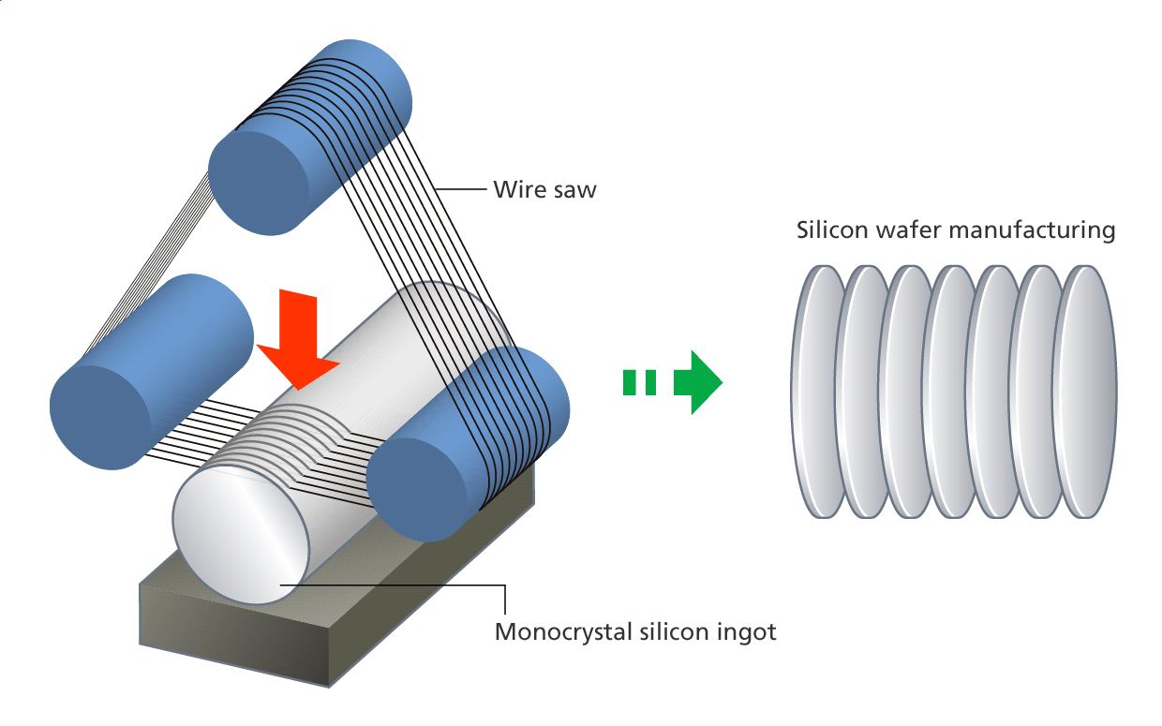
Silicon Ingot cutting into wafers

Slide 9
Identification of doping
Secondary flat
Secondary flat
Primary
flat
Primary
flat
(100) n-type
(100) p-type
Secondary flat
45 °
Primary
flat
Primary
flat
(111) n-type
(111) p-type

Slide 10
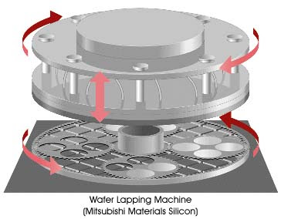
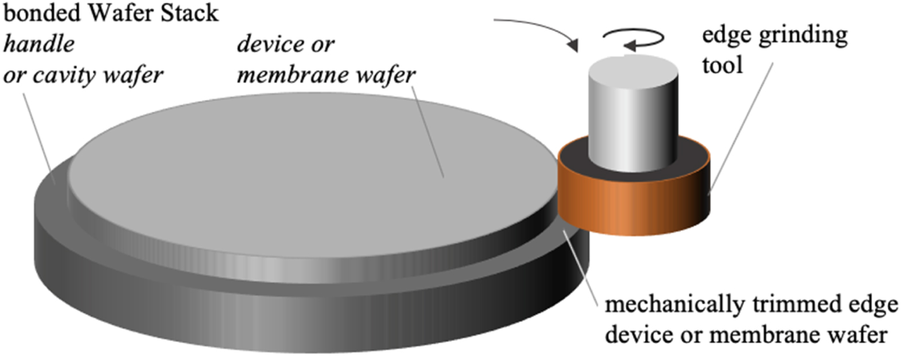
Wafer Lapping and Edge rounding:

Slide 11
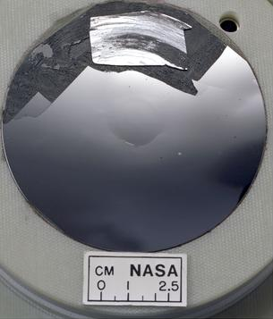
Finally, after polishing using silica and chemical treatment
Using SiO₂ particle and NaOH treatment

Slide 12
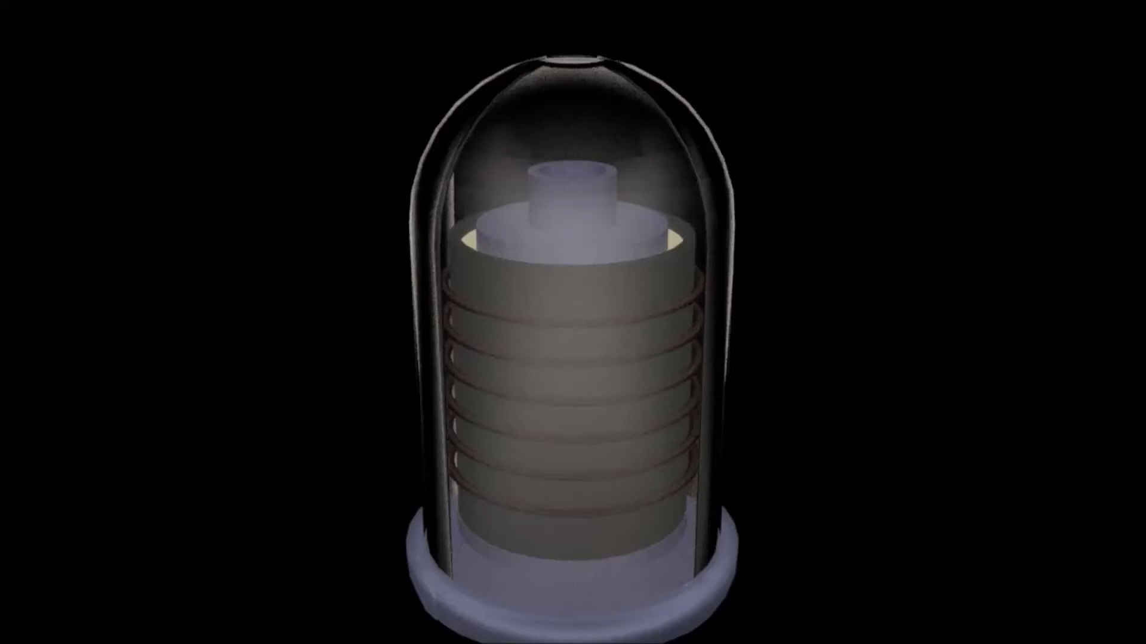
Video: YouTube

Slide 13
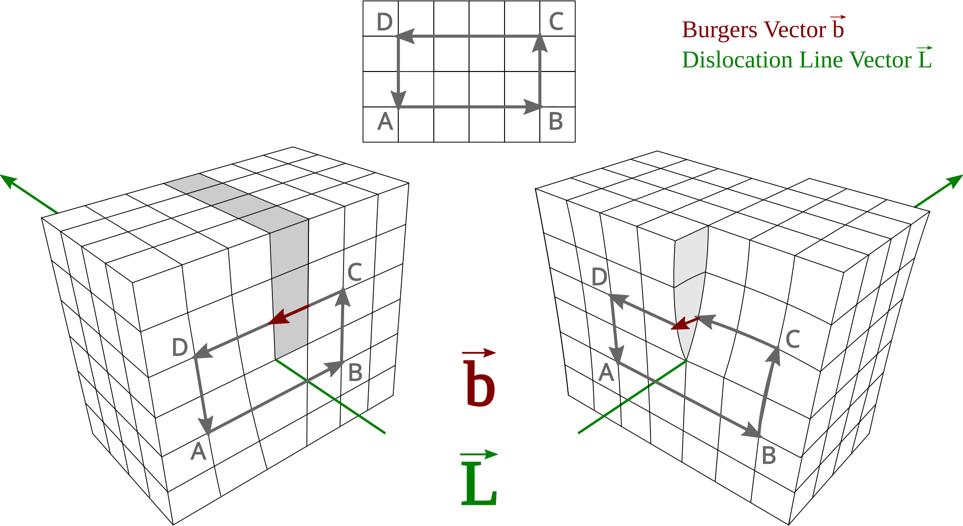
Edge dislocation
Screw dislocation
Burgers vector: magnitude and direction of the lattice distortion resulting from a dislocation in a crystal lattice.
What about point dislocation?
Image: Wikipedia

Slide 14
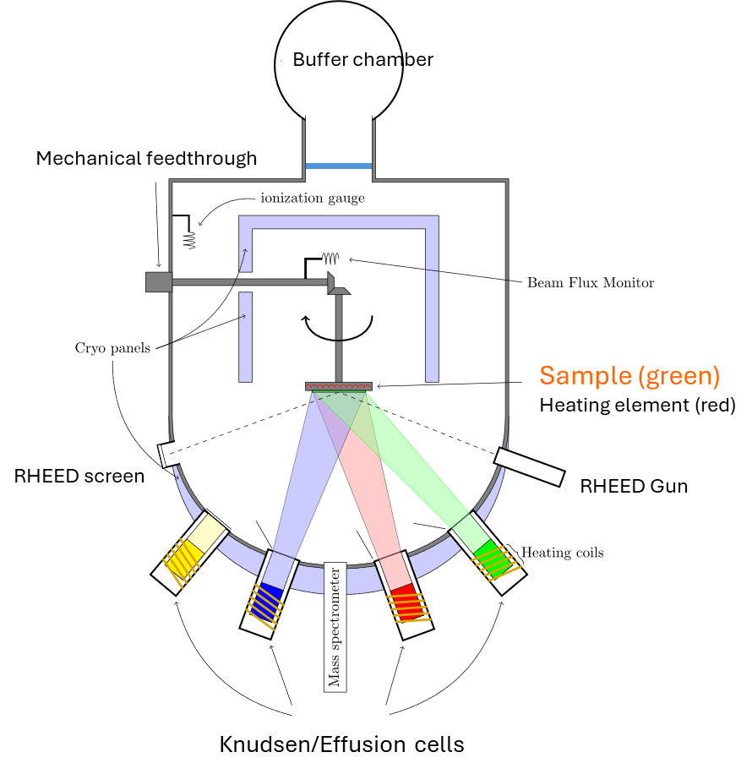
Molecular beam epitaxy:
Precursors:
Ga, As, In, etc

Slide 15
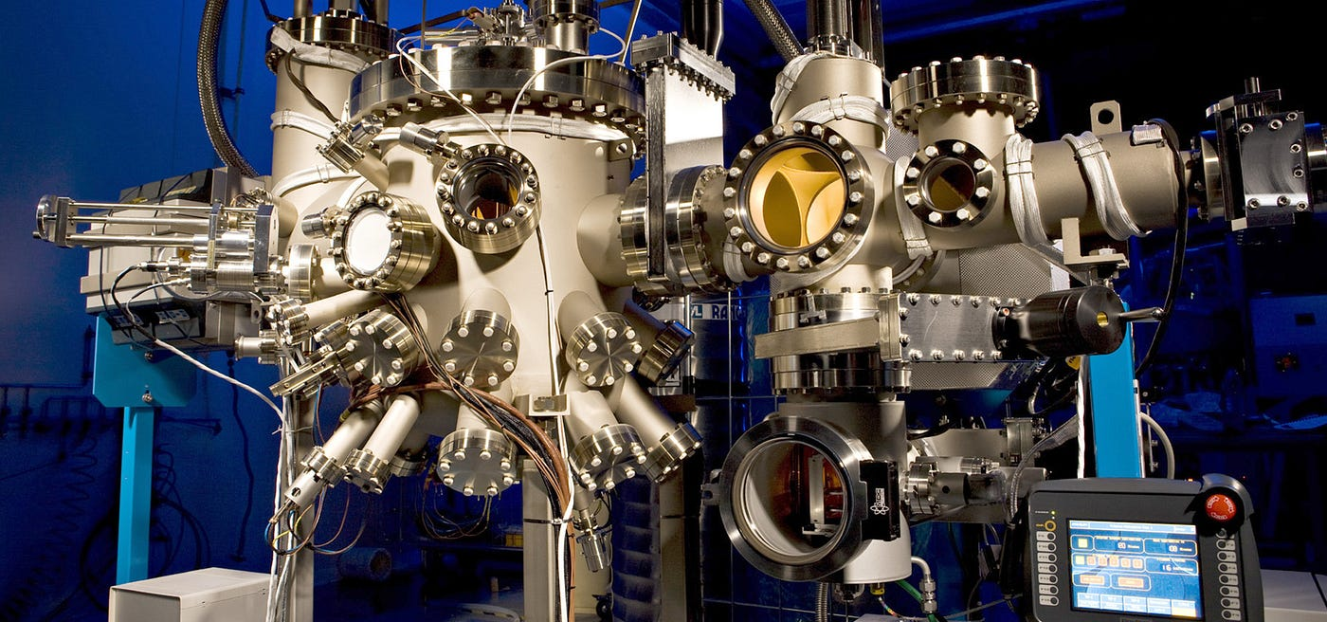
Molecular beam epitaxy:

Slide 16
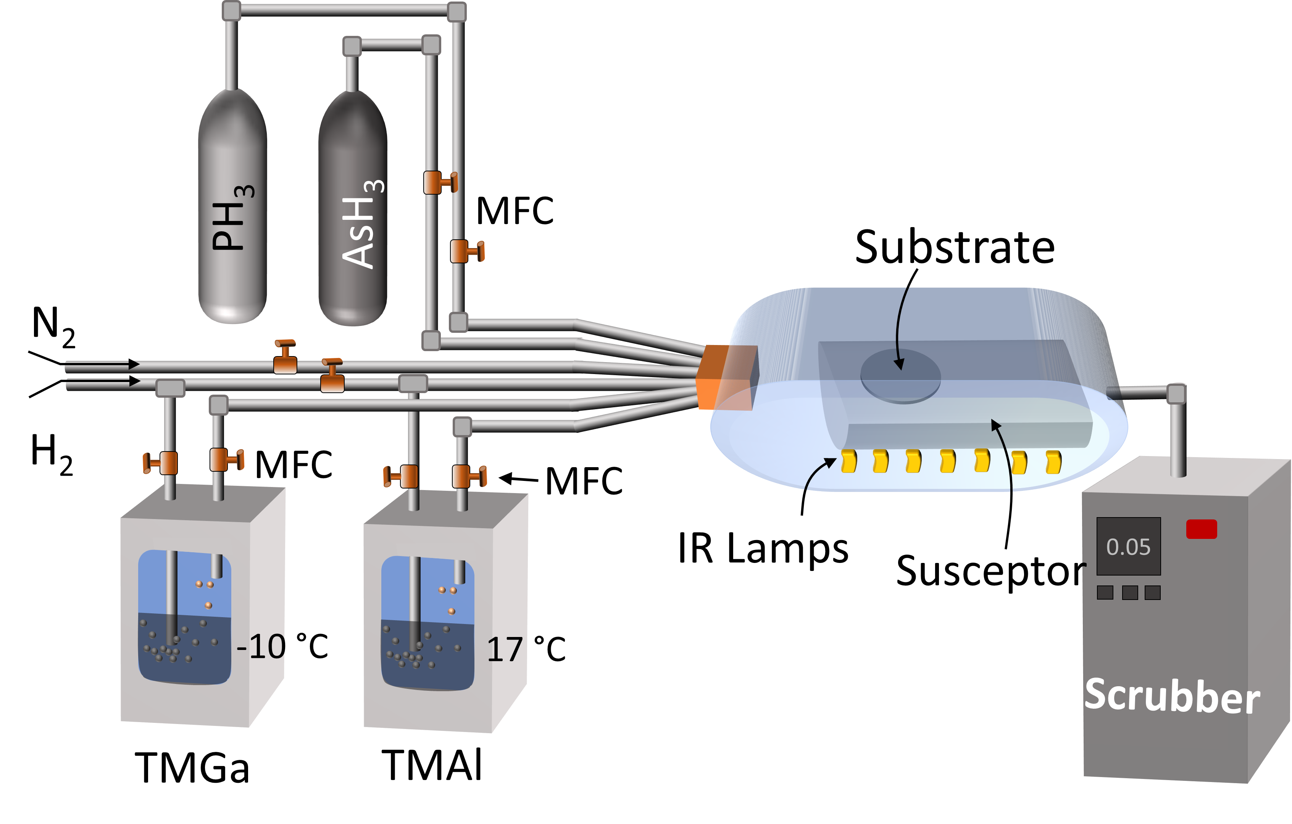
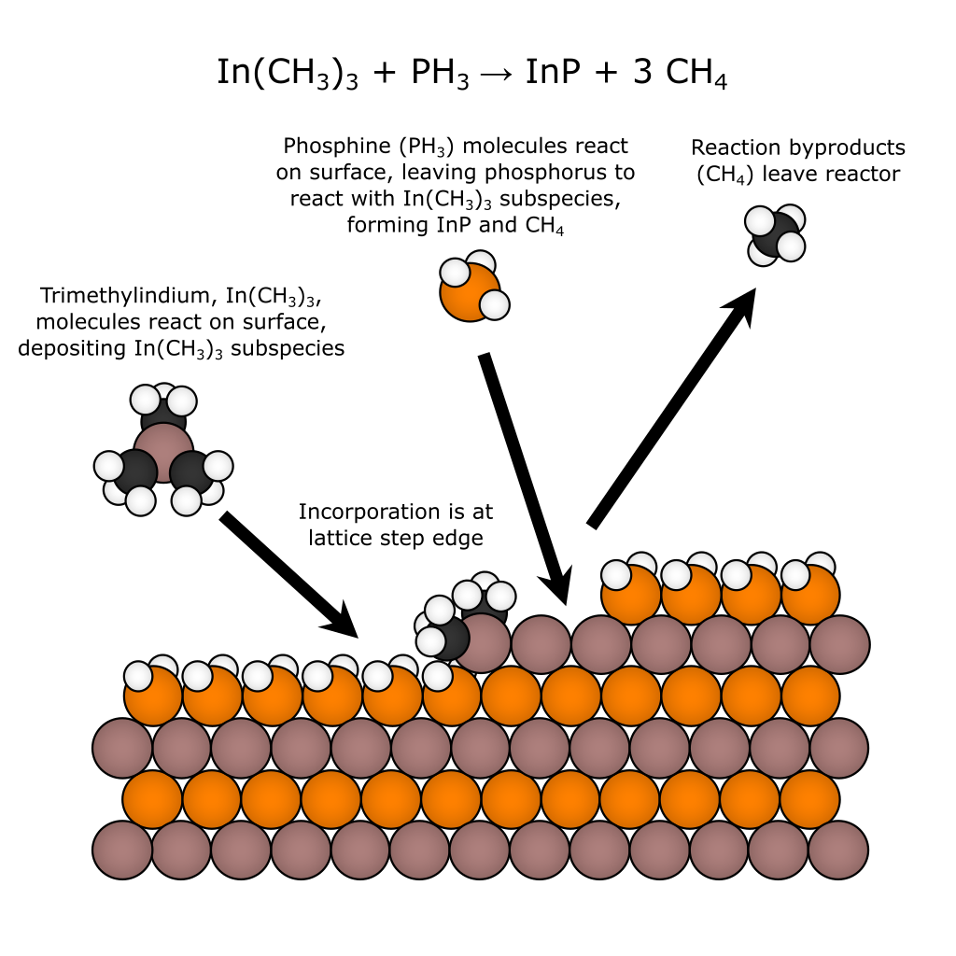
Metal organic vapor phase epitaxy:
Precursors:
Trimethylindium, (CH₃)₃In
Trimethylgallium, (CH₃)₃Ga
Triethylaluminium, (CH₃)₃Al
Arsene (AsH₃),
Phosphine (PH₃),
Silane (SiH₄)
Image: PhD Thesis, Subhomoy Haldar

Slide 17
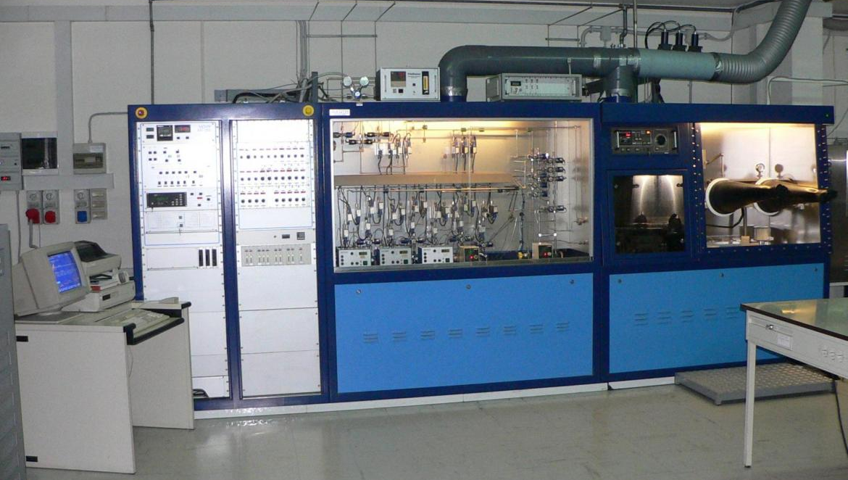
Metal organic vapor phase epitaxy:

Slide 18
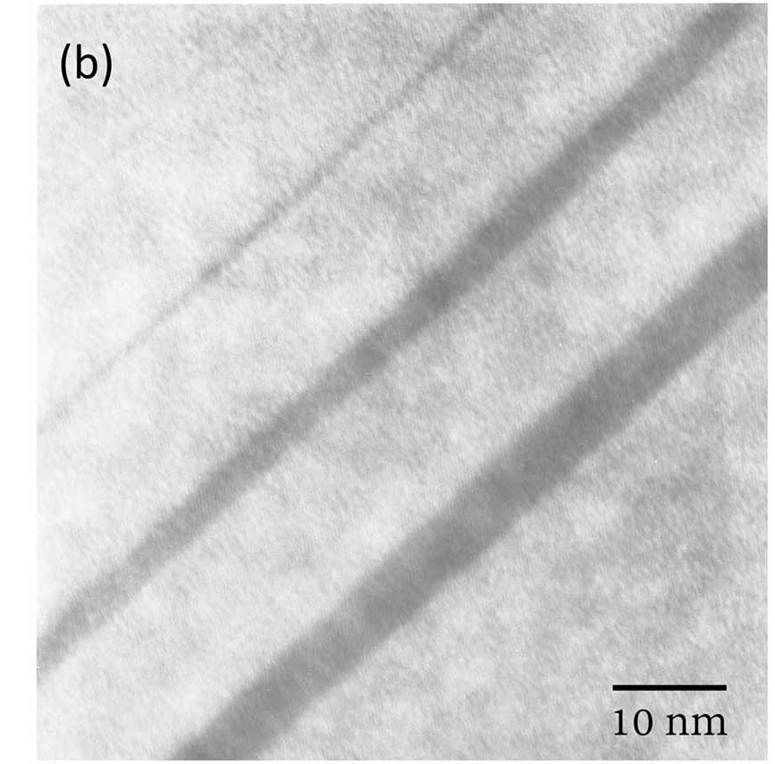
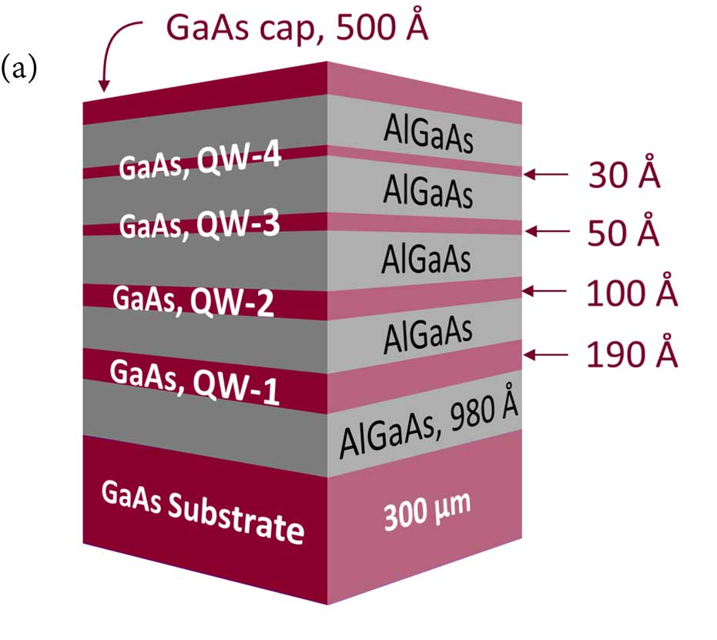
Growth of quantum well:
Cross sectional Transmission electron microscopy
Image: PhD Thesis, Subhomoy Haldar

Slide 19
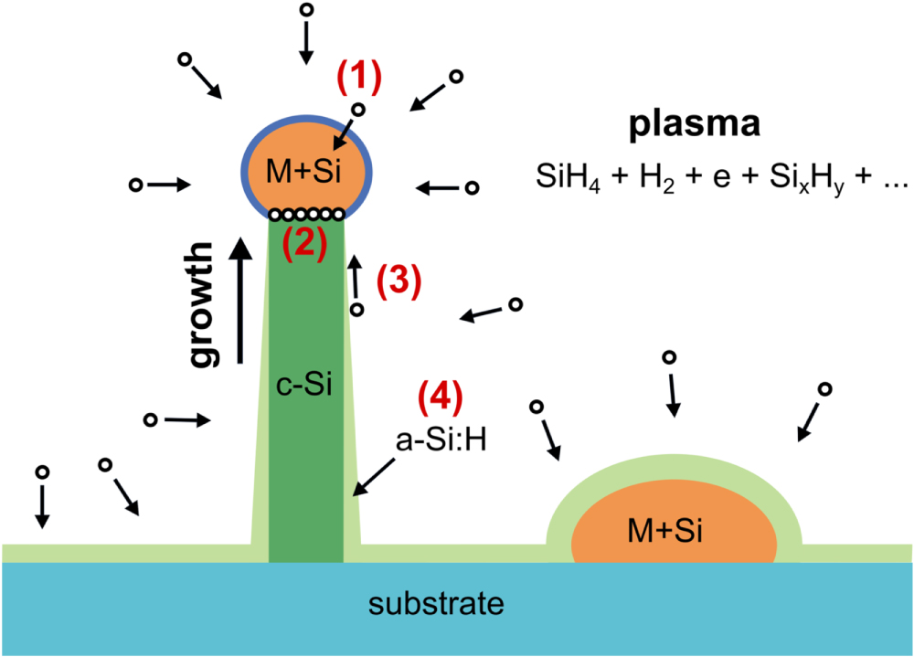
Vapor Liquid Solid Crystal growth

Slide 20
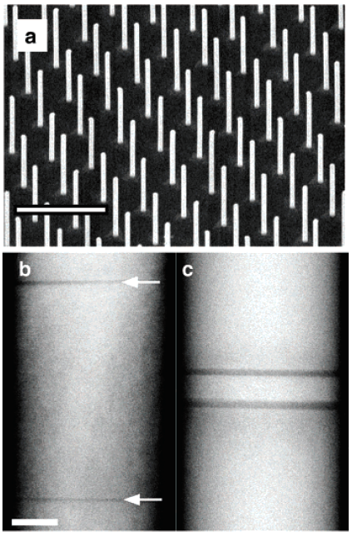
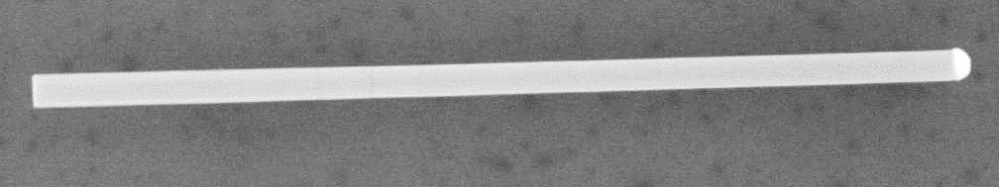
Nanowire growth and heterostructures
70 nm
InP
InP
InAs
Au
ΔE_{c} ≈ 600 meV
Conduction band, E_{c}
nanowire
QD
nanowire
M. T. Björk et al. Nano Lett 4, 1621 (2004)
Valence band, E_{c}

Slide 21
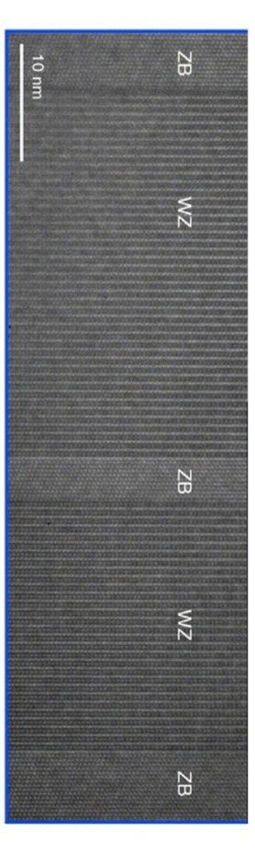
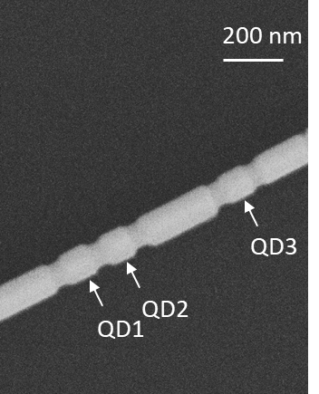
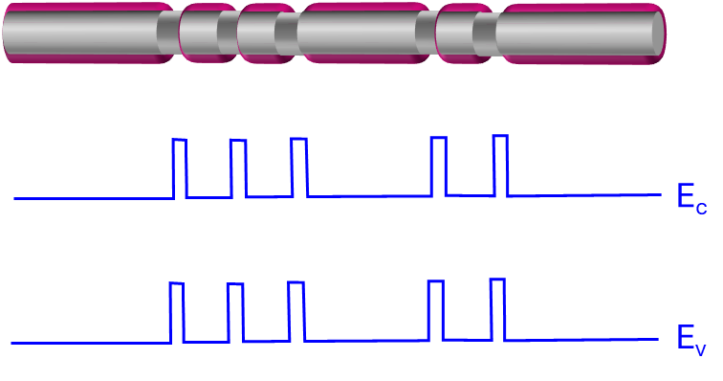
Crystal phase defined Quantum Dot
InAs Zincblende
InAs Wurtzite
GaSb shell
Nanoscale Adv., 5,1890 (2023)

Slide 22
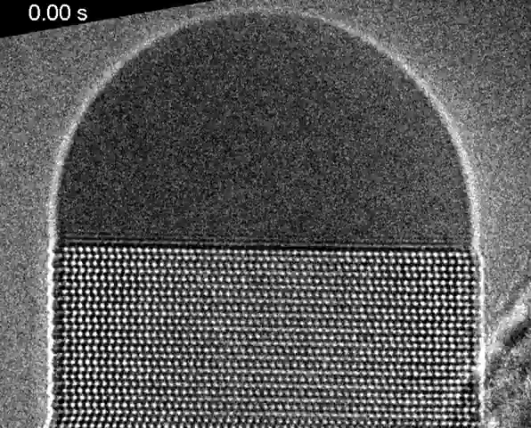
Nanowire growth
Video: YouTube

